Slide 1
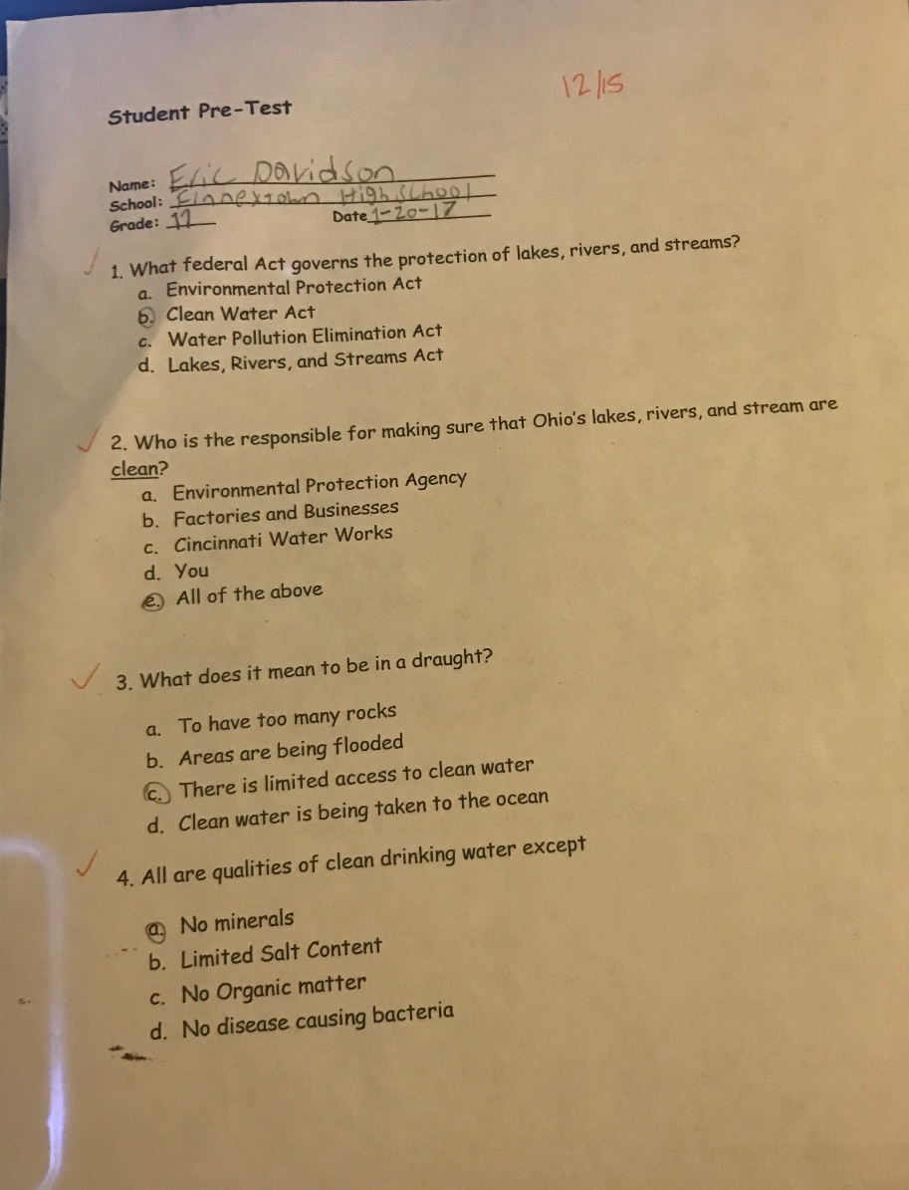
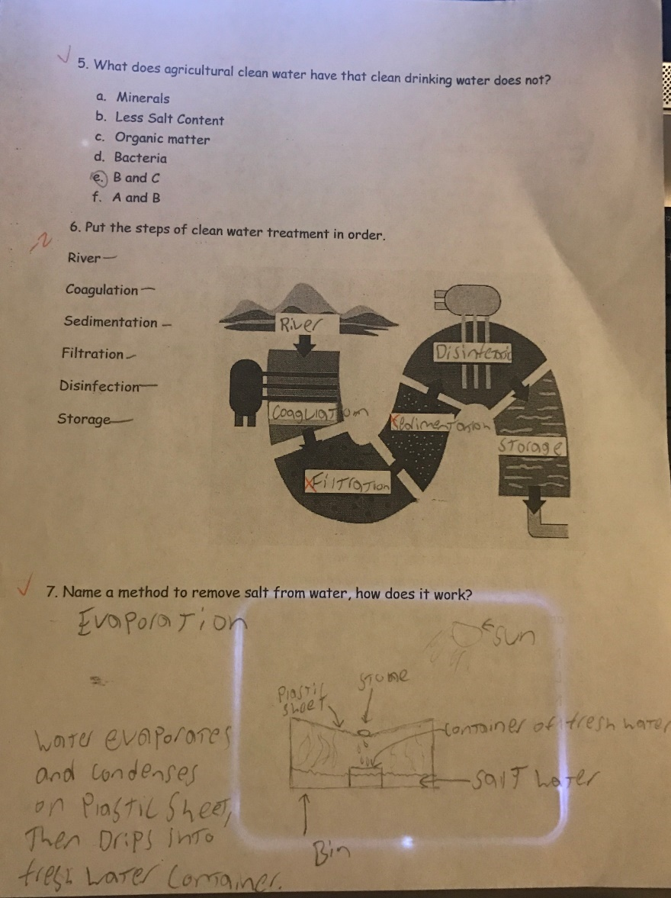
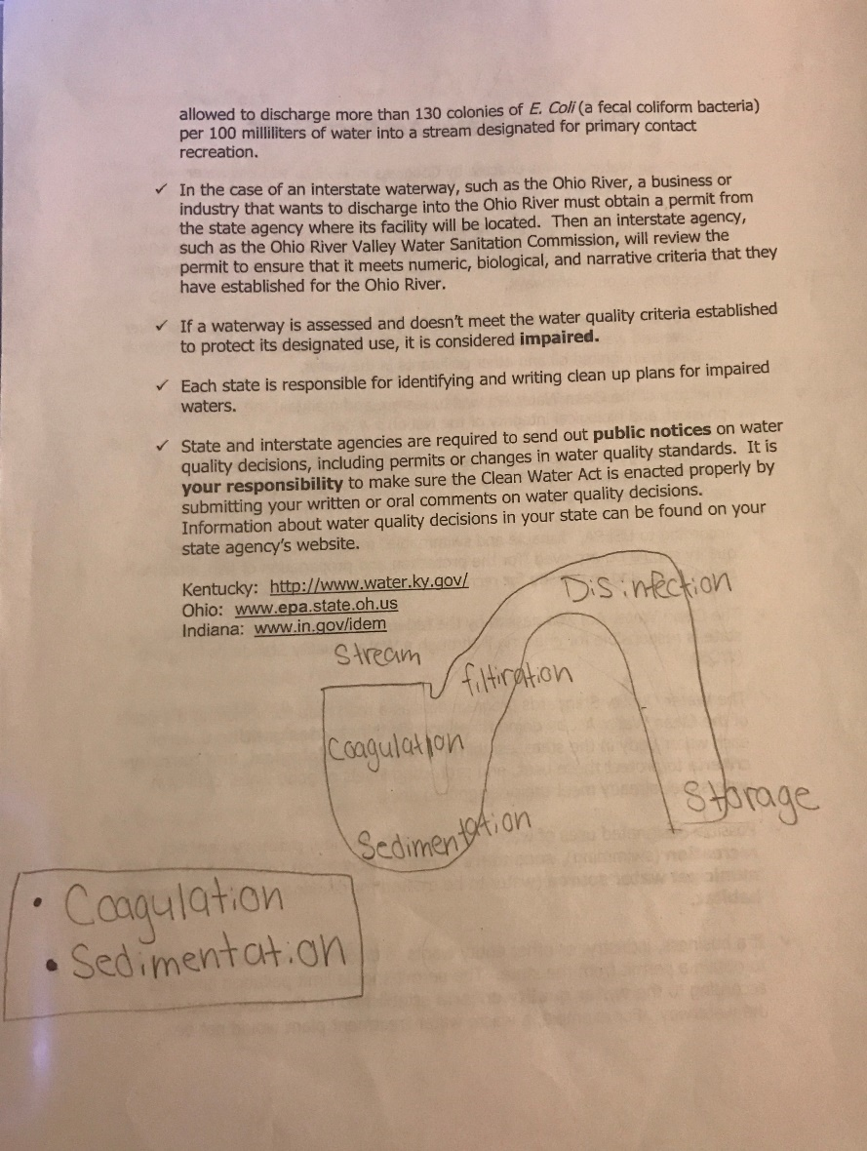
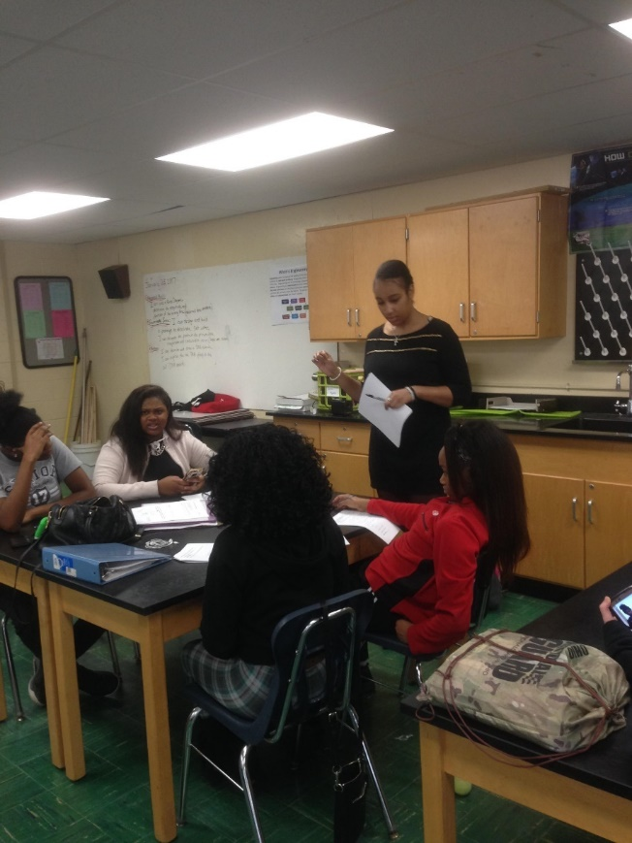
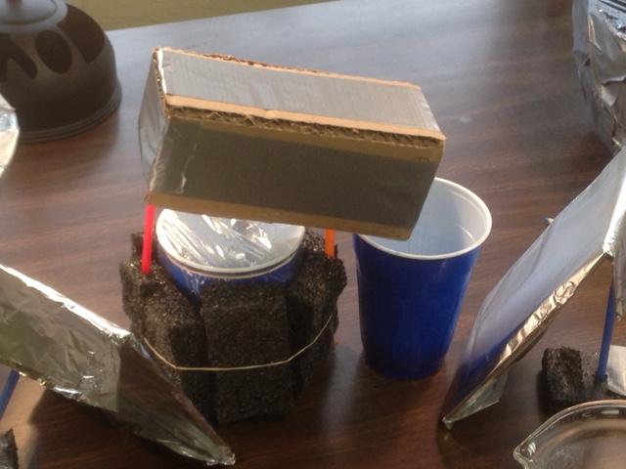
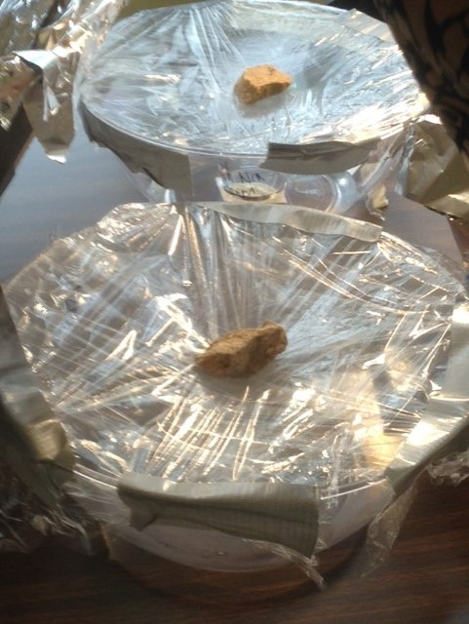
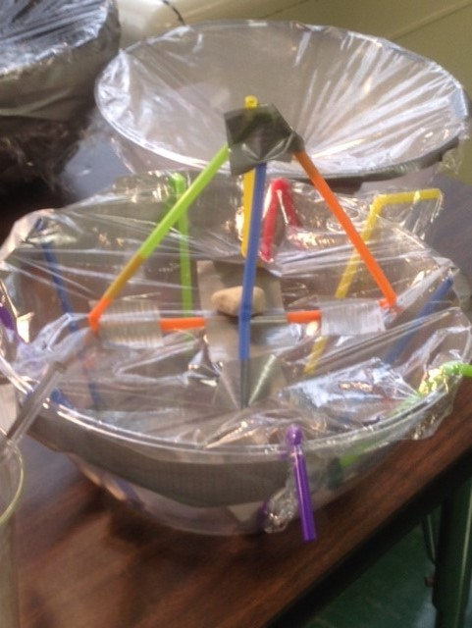
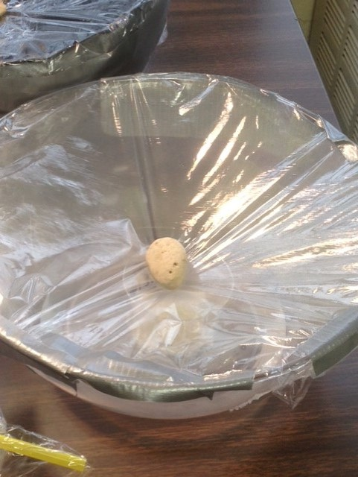
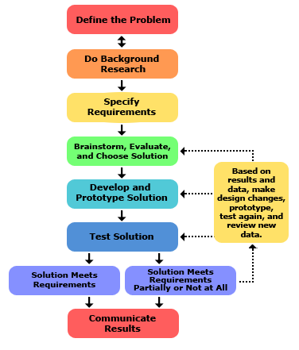
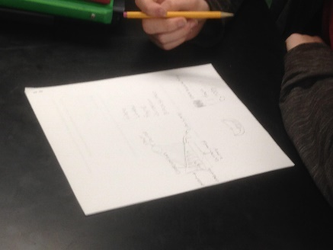
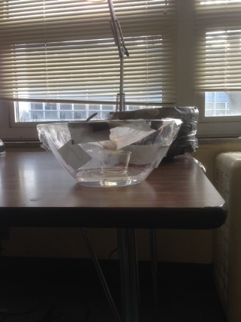
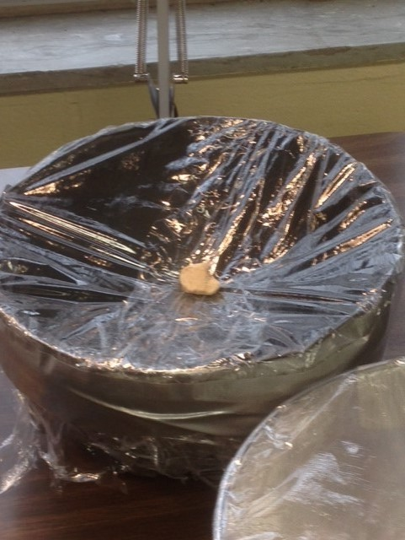
Clean Water and Solar Stills Neah Gray, Environmental Engineering Finneytown High School, Environmental Science
RET is funded by the National Science Foundation, grant # EEC-1404766
Unit Overview
Activity Implementation
Student Work
Topic:
Purification and Clean water
Standards:
Next Generation Science Standards:
Science and Engineering Practices-
Asking questions and defining problems
Developing and using models
Analyzing and interpreting data
Obtaining, evaluating, and communicating information
Crosscutting Concepts-
Cause and effect, Systems and system models
Structure and function
Ohio’s Learning Standards of Science: TDC and R
Unit Academic Standards: Ohio Science Standards- EVS
Earth resources (Water pollution)
Global Environmental Problems and Issues
Pre-Test
Review of Clean water criteria and wastewater purification process
Review Real-world applications of clean water issues
Introduce concept of Solar Stills
Students begin lab with potential modelled solar still
Designs are analyzed and best design built
Midway modifications and peer critiques
Water results recorded
Data Analysis
Peer review of top designs
Post Test
Pre and Post Test Assessment
Wastewater Purification and Clean water standard notes
Assessment Results:
Impact on Student Learning
Discussion of solar still models
Unique Design based on principles of Condensation and Evaporation
Student’s Modified Design
Student’s
Unique Design
Activity Structure
Engineering Design Process
Title: Clean water and Solar Stills
Guiding Questions:
What are some issues regarding water in today’s society?
What is clean water? How do we know?
What are the different uses of water and how does the quality vary from purpose to purpose?
What are the steps in the water purification?
How do you create a solar still that utilizes the steps in water purification?
Objectives:
Identify some big issues regarding water in today’s society.
Define clean water.
Compare and contrast the different purposes of water.
Identify the steps in water purification.
Design a solar still that utilizes the steps in water purification.
Videos on Flint, Michigan and California
Model with condensation observed
Water purification process and Solar Still Explanation
Reflection and Conclusion
Lab Worksheet
The students understanding of the material discussed and taught have shown to improve with the utilization of the Pre and Post Tests as the main means of cognitive assessment.
For future implementations, there will be less usage of interactive forums that require free time. This causes students to lose focus and become off task.
Design example
Student model example
Student model with modifications
ACS:
Application- World clean water crisis (i.e. Flint, MI and SoCal) Industrial Solar Stills used in some countries to purify sea water
Careers- Cincinnati Water Works
Societal Impact- Increase clean water

